Slide 1
A-ONE Customer Portal Guide

Slide 2
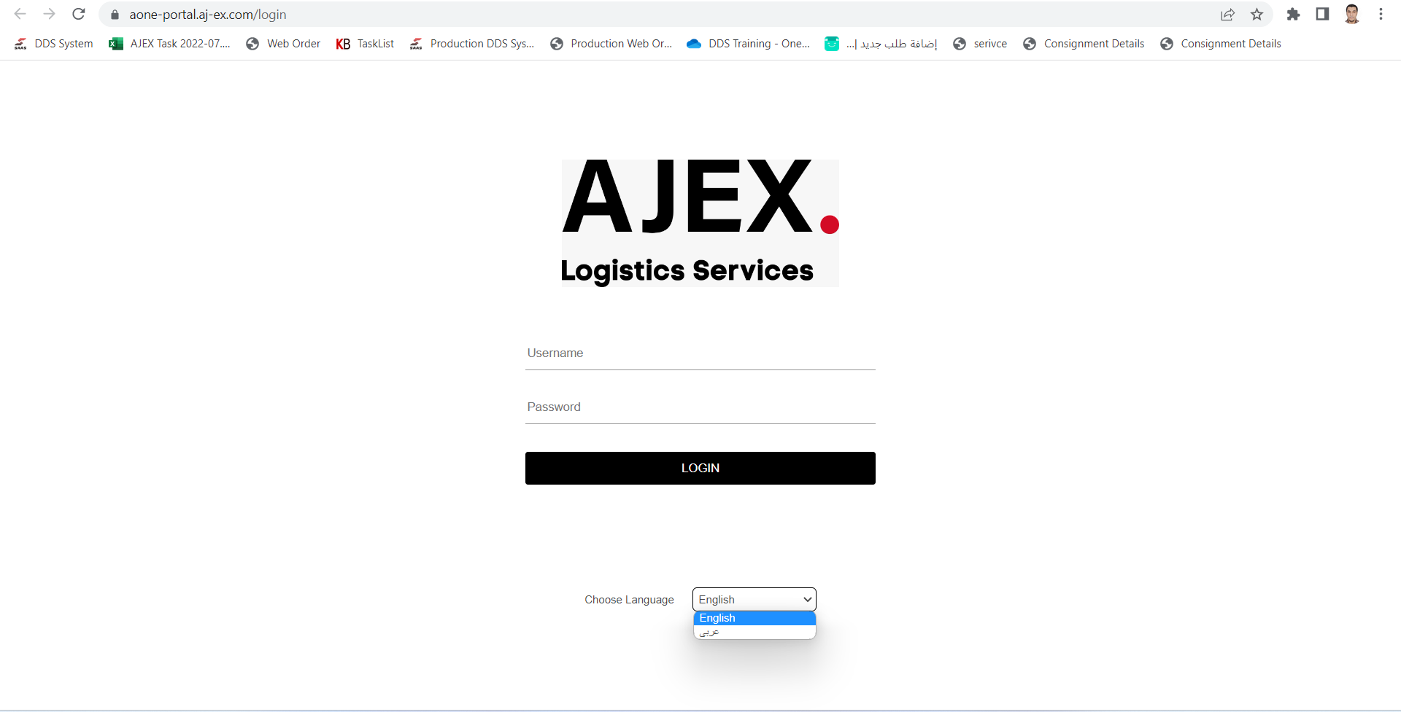
LANGUAGE SELECTION
Please select the preferred language.
Please follow the link: https://aone-portal.aj-ex.com/login to access the enterprise portal of AJ-EX.

Slide 3
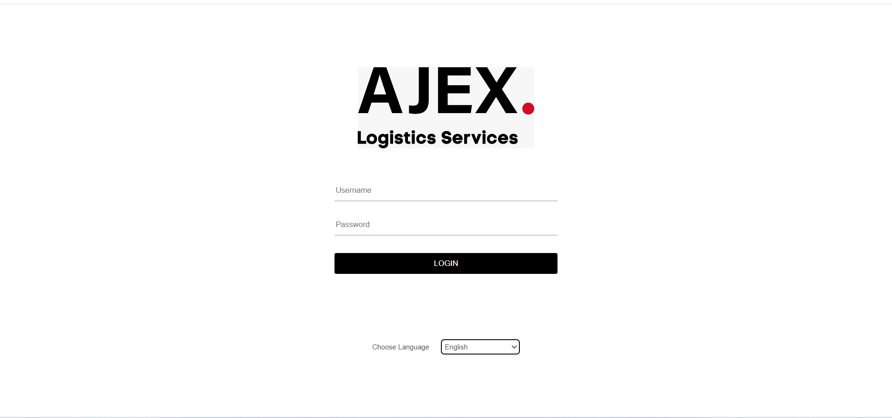
Login Into System
Enter your Username and Password, then click on <<LOGIN>> Button

Slide 4
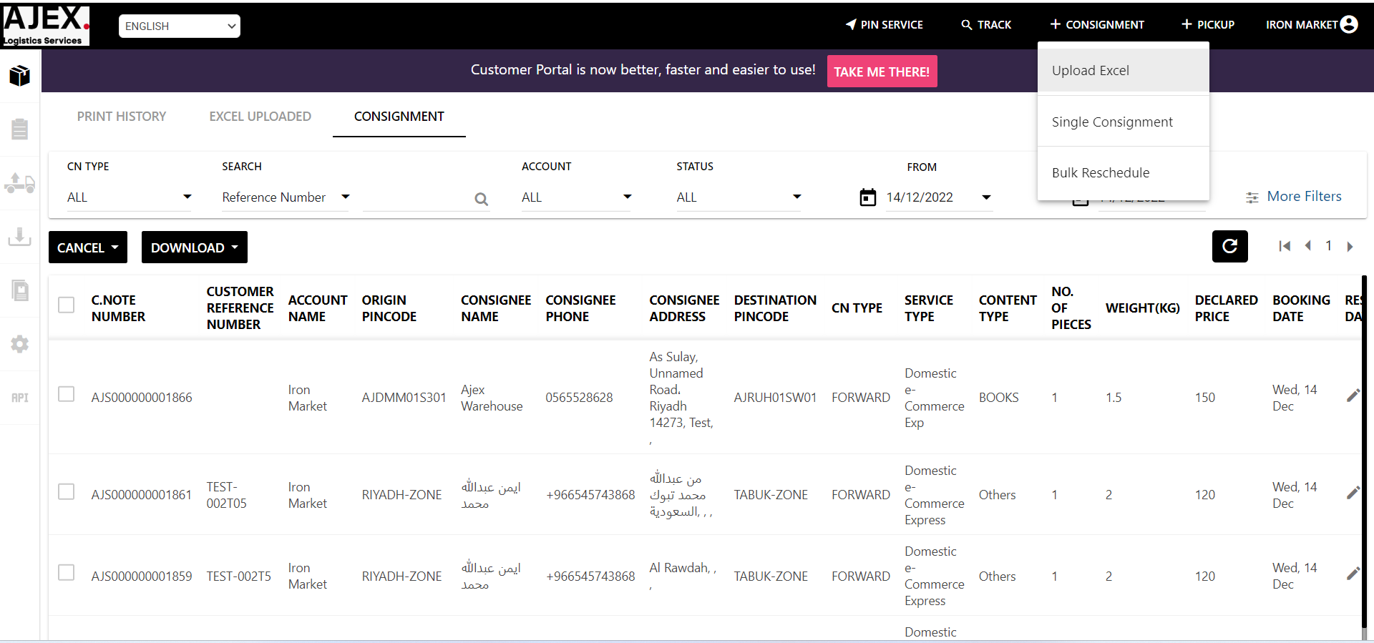
Order upload using excel
Click Here

Slide 5
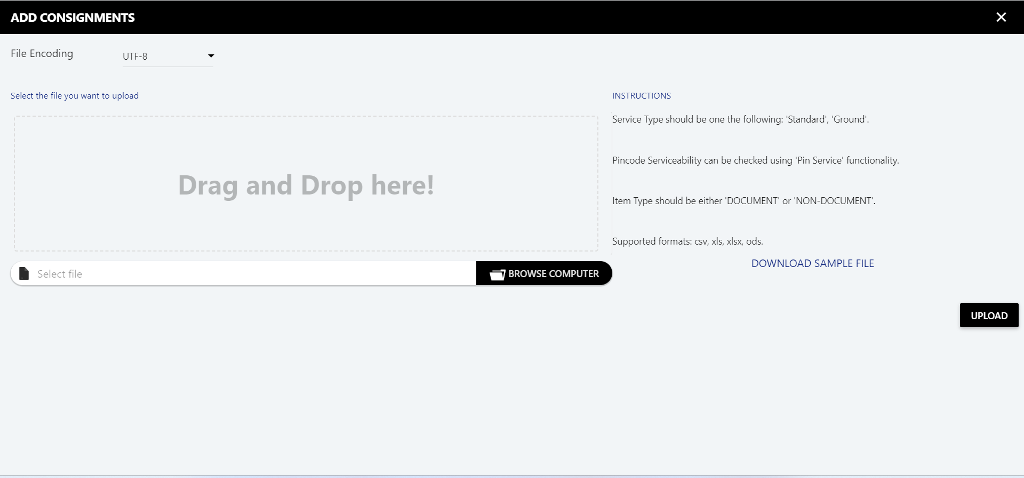
Order upload using excel
Click Here

Slide 6
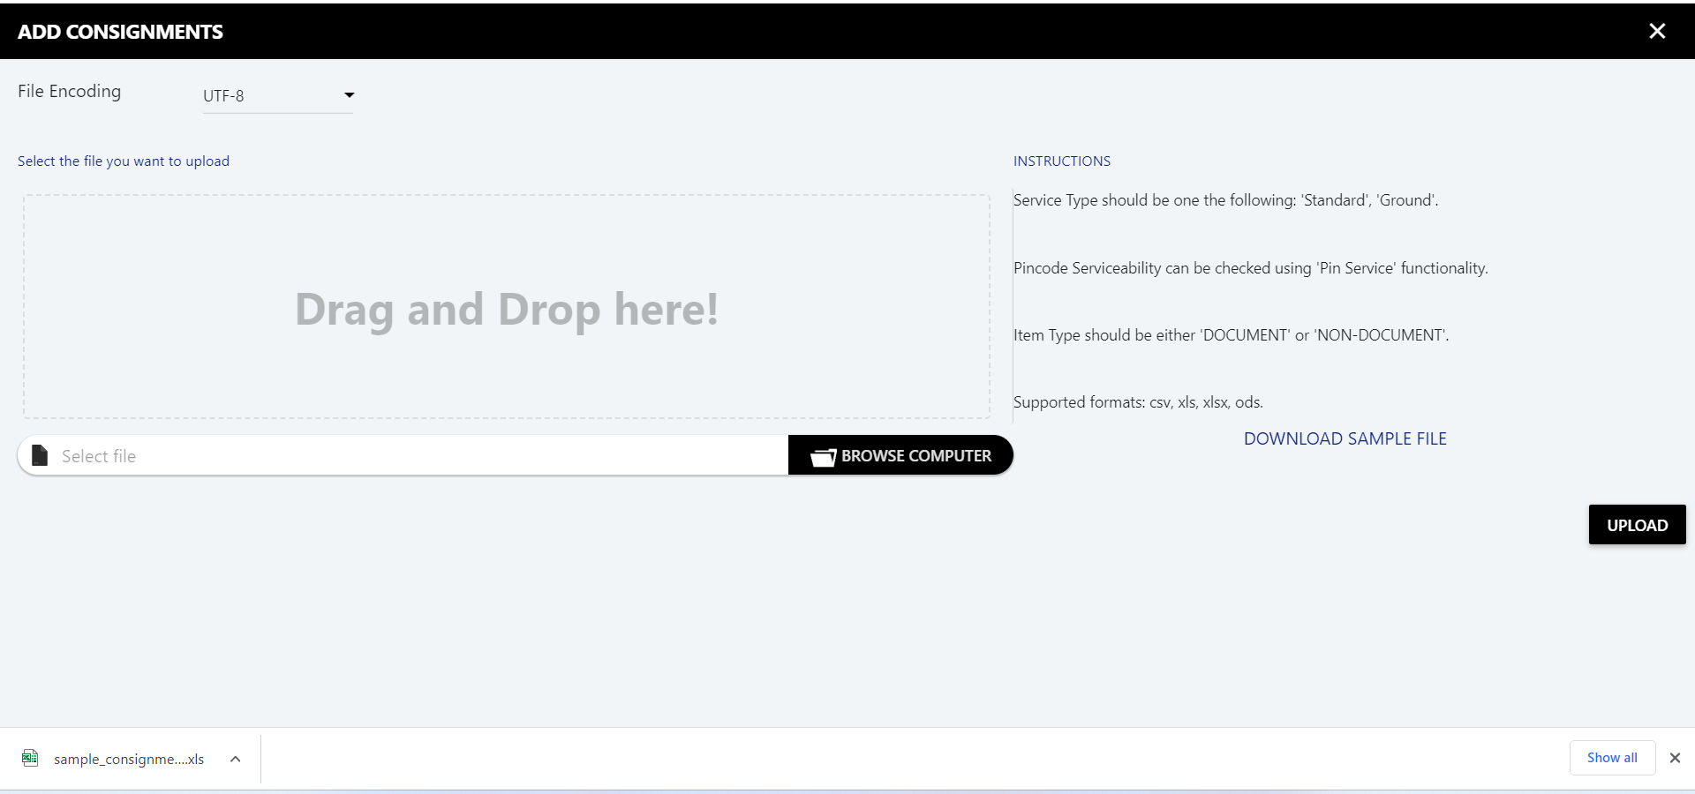
Order upload using excel
Open File

Slide 7
Order upload using excel
Please fill in all the required columns.
Must fill in with unique value
These fields optionally (Origin Address Line 2, Destination Address Line 2, Consignment Type, Receiver Civil Id, Destination Latitude, Destination Longitude)
If there is incorrect information, then the order will not get created in the system.

Slide 8
Order upload using excel
Please fill in all the required columns.
Then go to the next Sheet Pieces.
Click Here to Add Pieces

Slide 9
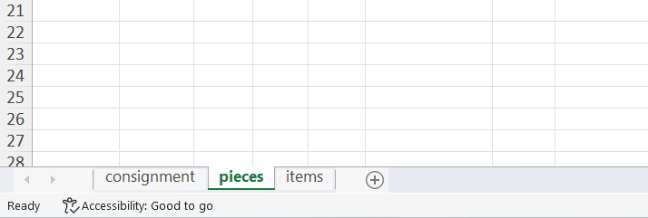
Order upload using excel
Please fill in all the required columns.
Each row with the same Unique ID represents one piece for that Unique ID in Consignment Sheet
Click here to add items for one or more pieces

Slide 10
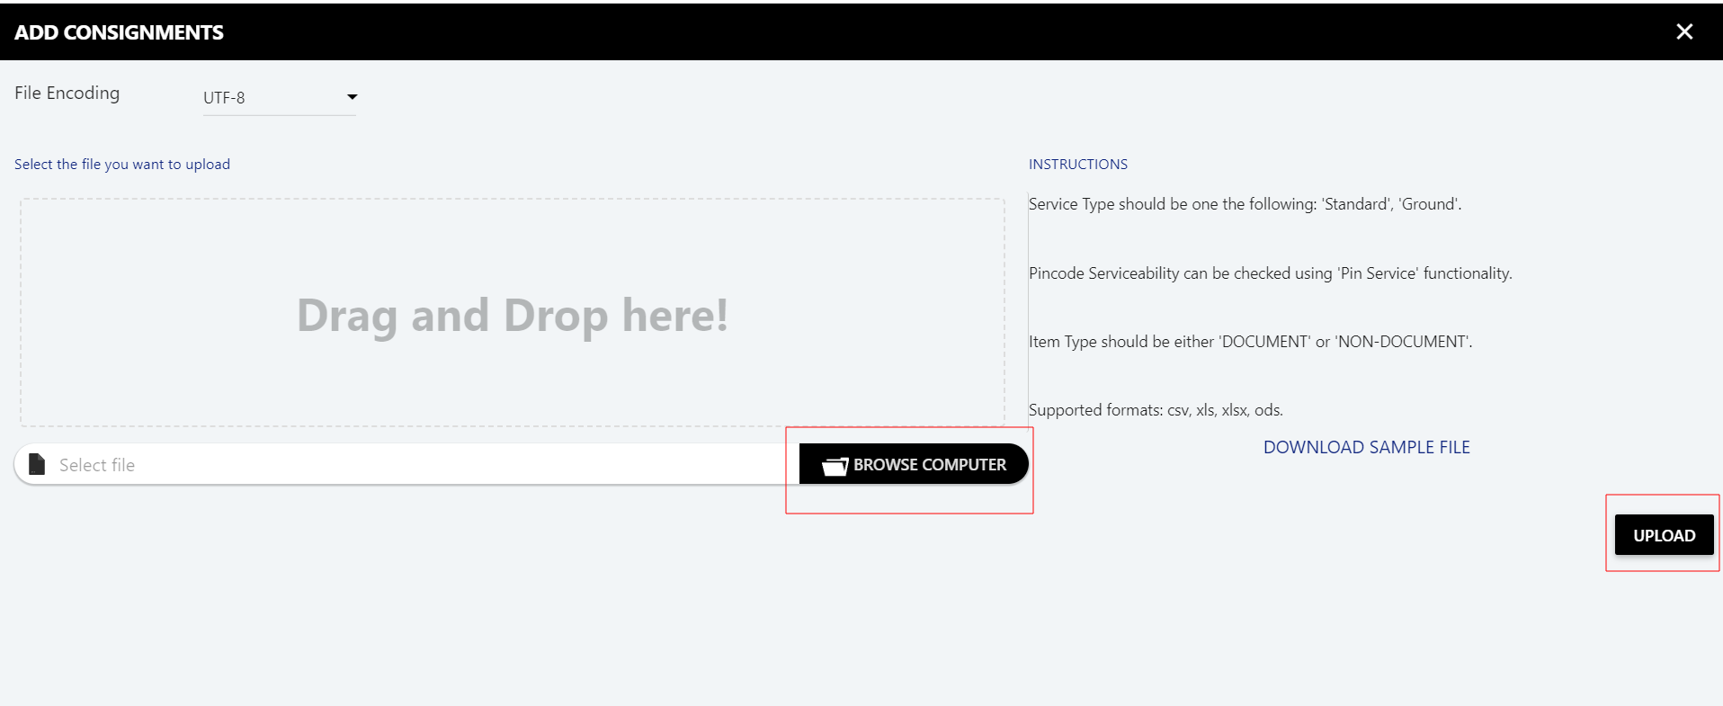
Order upload using excel
Please fill in all the required columns.
Each row with the same Unique ID represents one item for that Unique ID in Pieces Sheet
After filling out the file, save it, then upload that, then click on the upload button

Slide 11
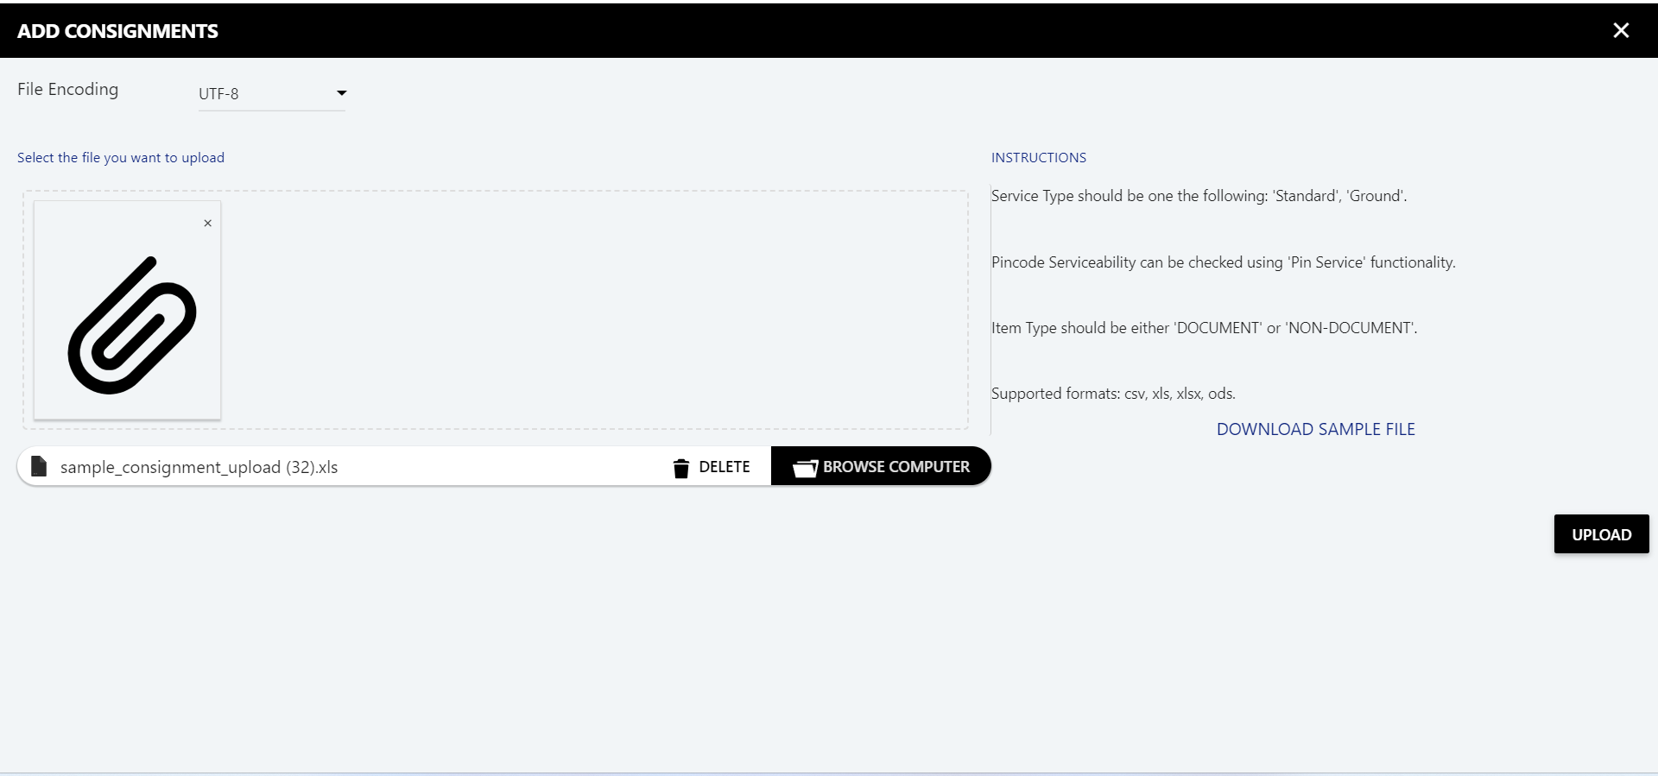
Order upload using excel

Slide 12
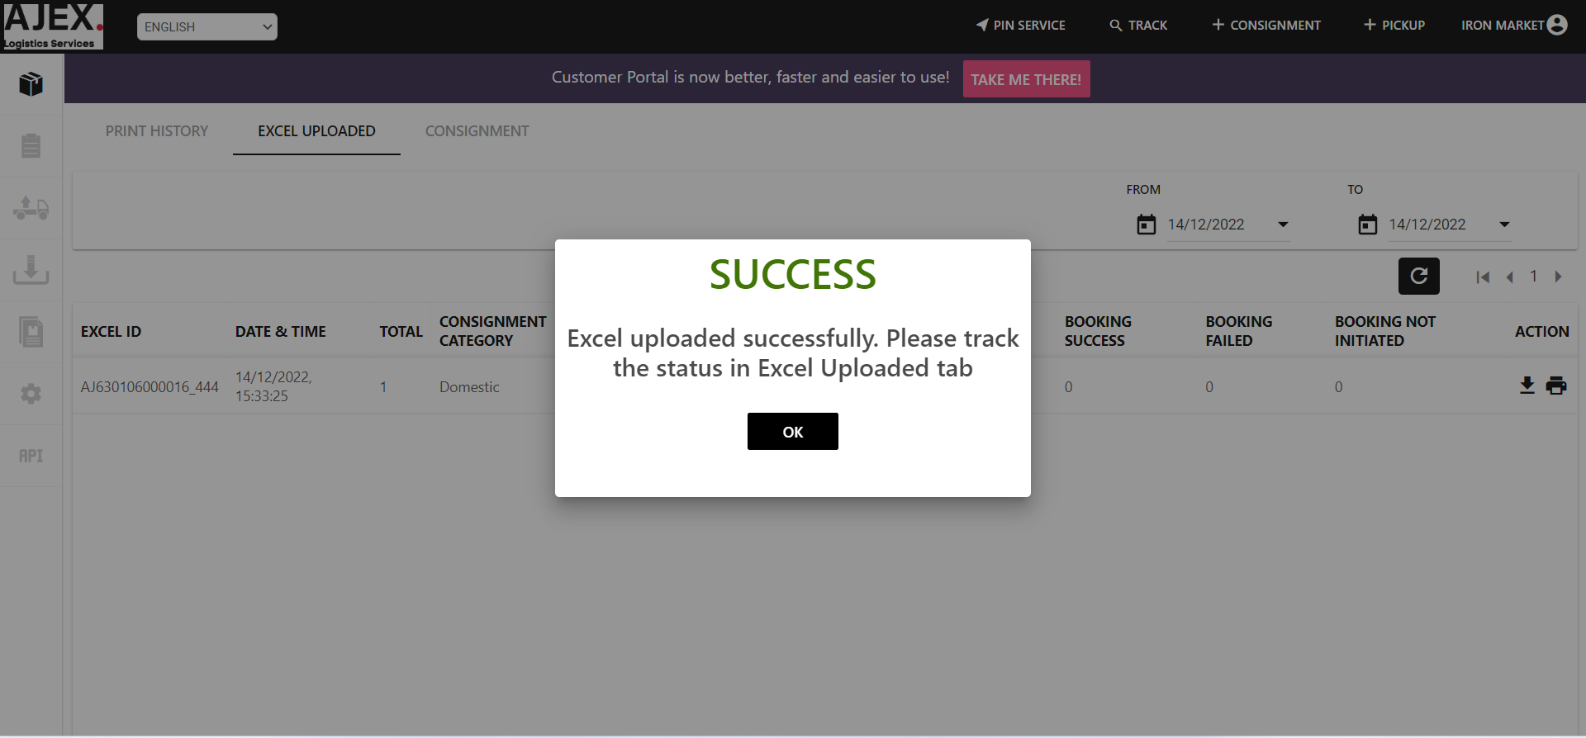
Order upload using excel
This message means you can upload success as an excel file but not a success for the creation order
Click here

Slide 13
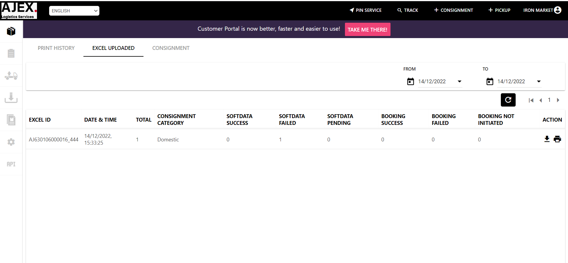
Order upload using excel
This means you have one order been failed.

Slide 14
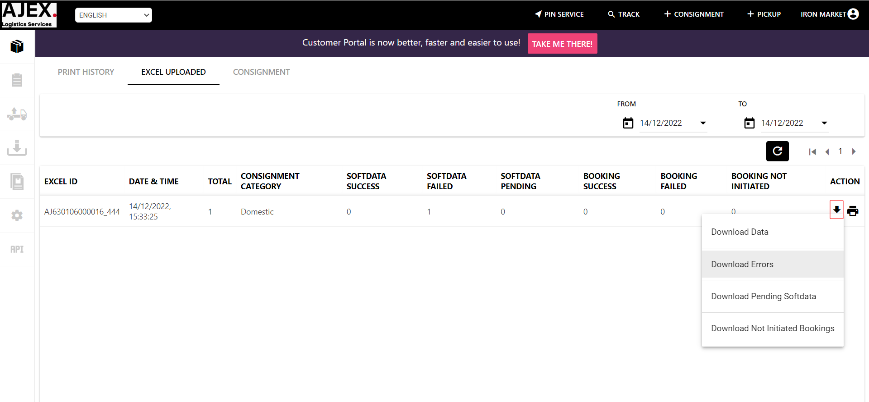
Order upload using excel
Click here to find out error message

Slide 15
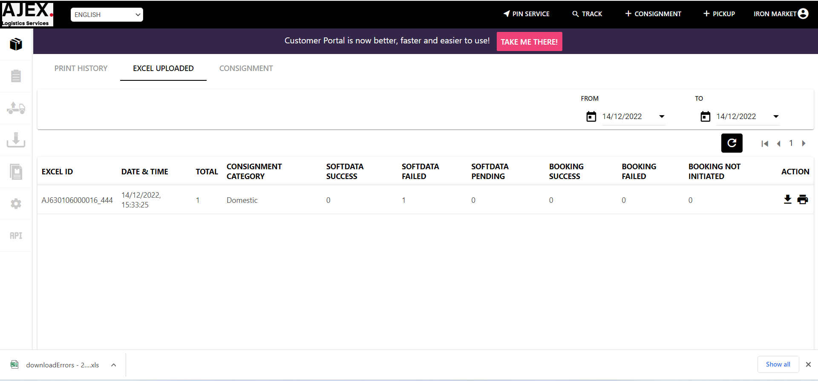
Order upload using excel
Open file

Slide 16
Order upload using excel
This is an error.
Please re-open your file and update the information according to the error message you got, then re-upload again.
This means you have created your order successfully

Slide 17
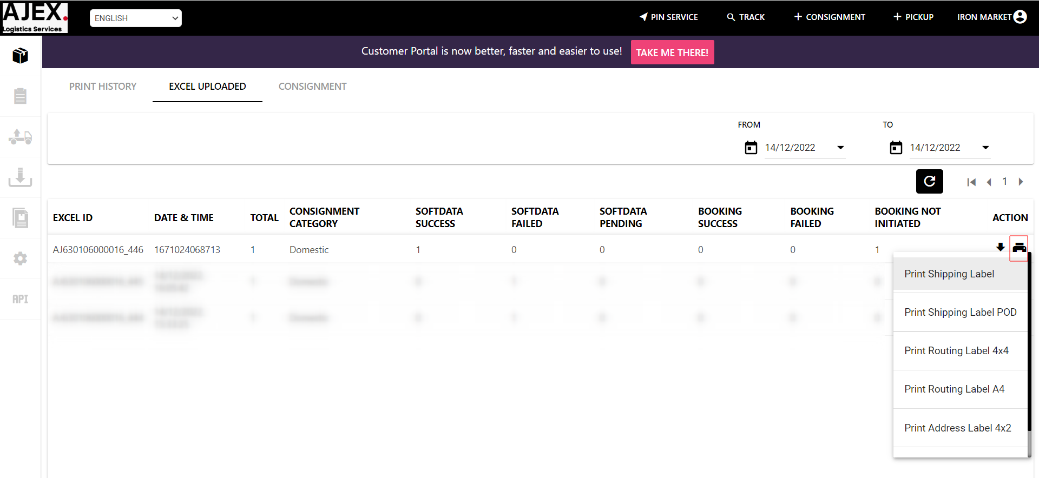
Printing Waybill
Click here to print your waybill.

Slide 18
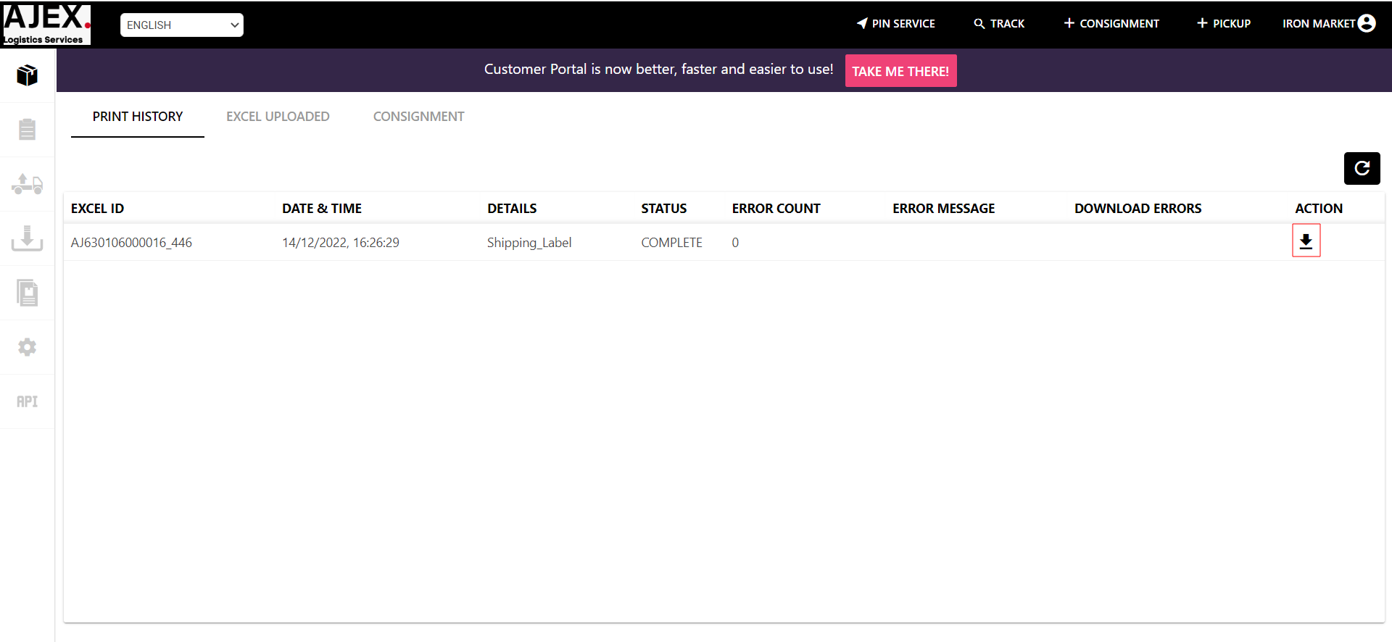
Download the PDF file for Waybill
Click here to download the pdf file

Slide 19
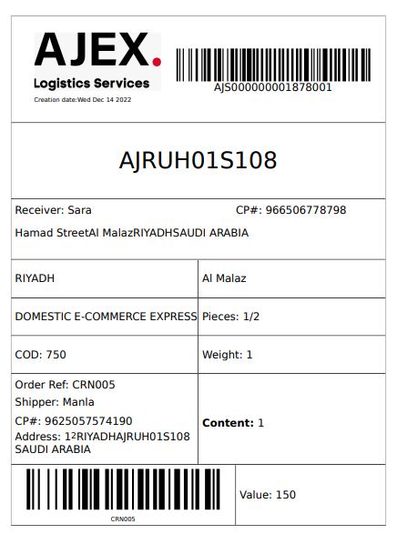
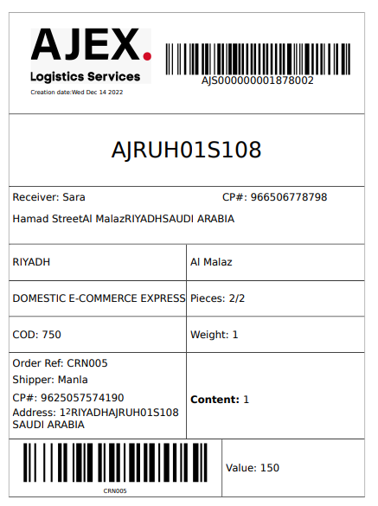
Print Waybill
The waybill will download/open in PDF format.
Waybill Sample

Slide 20
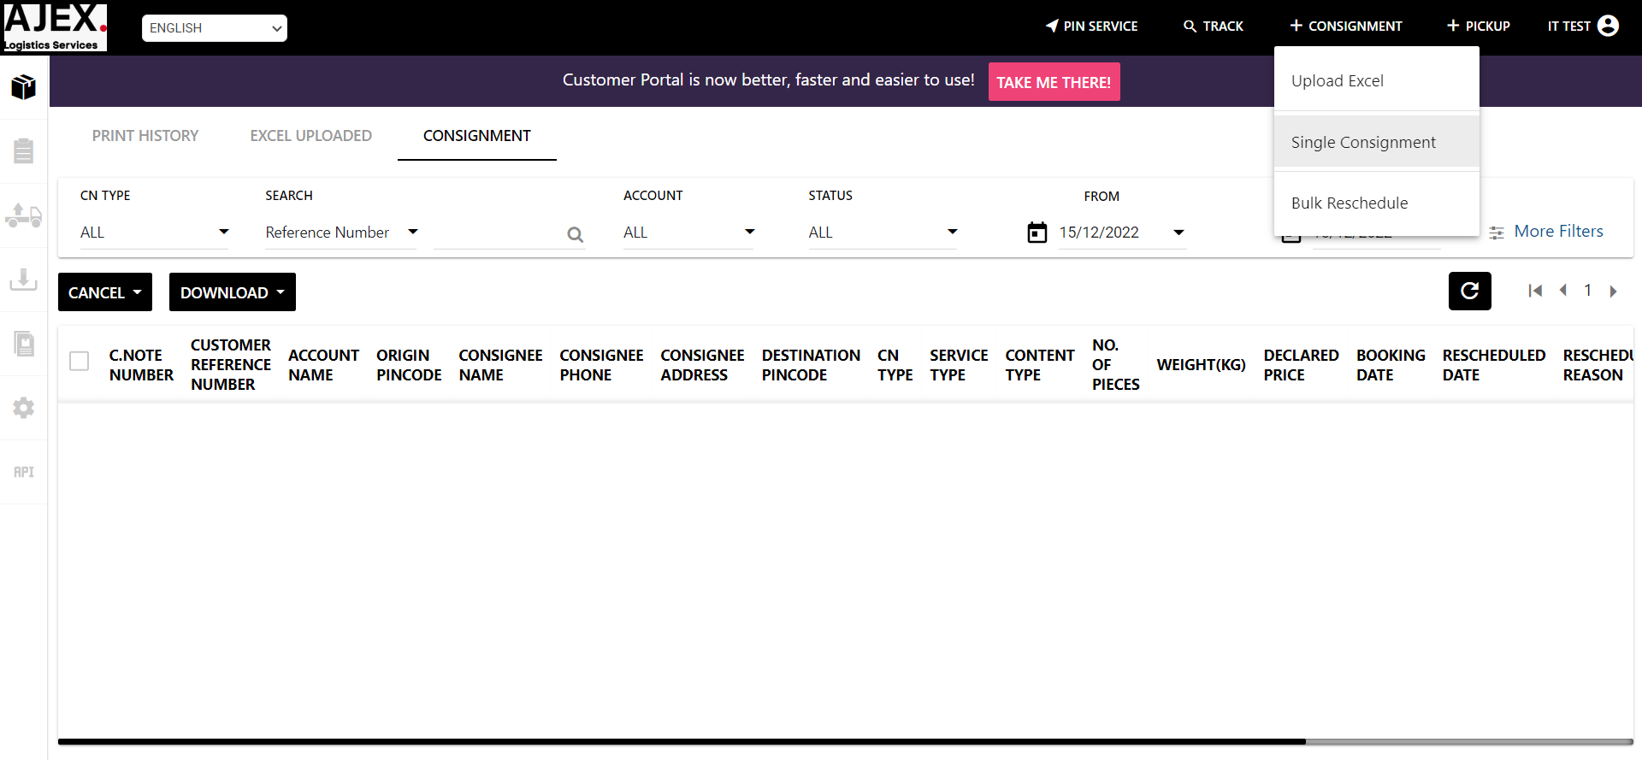
Create Single Order
Click Here

Slide 21
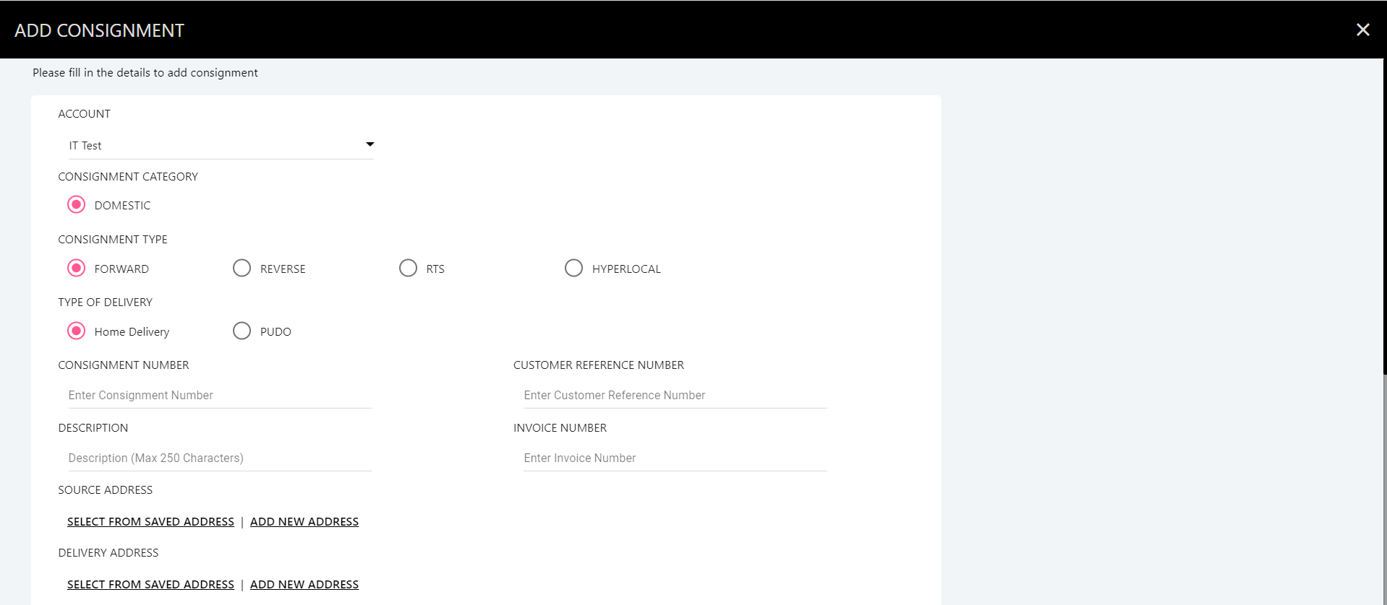
Create Single Order
Enter the Customer Reference Number, then the Description for your shipment.

Slide 22
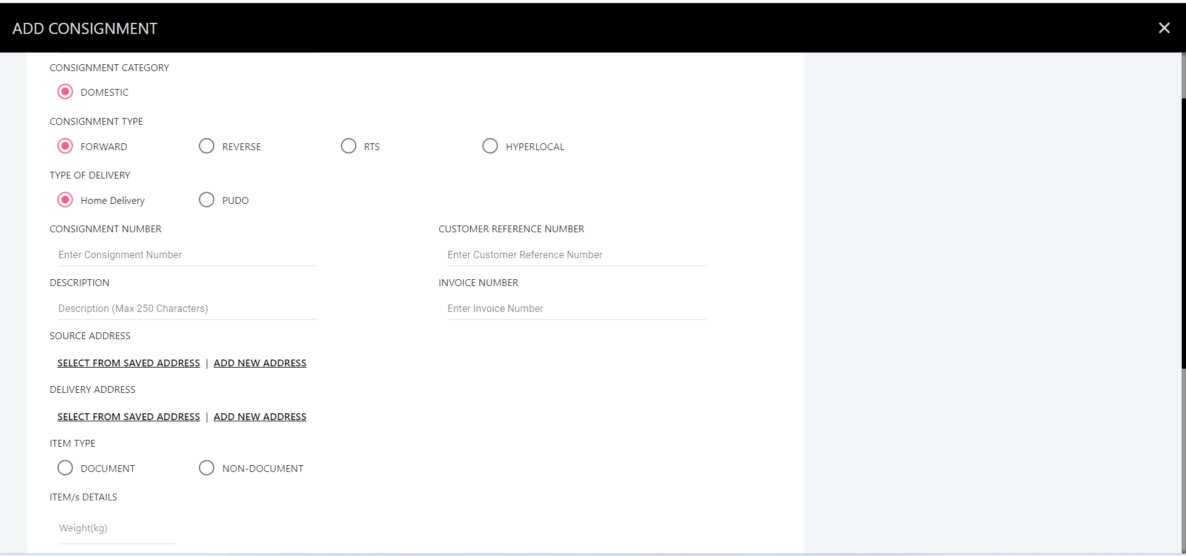
Create Single shipment – Add Source Address
Click Here to fill in the source address

Slide 23
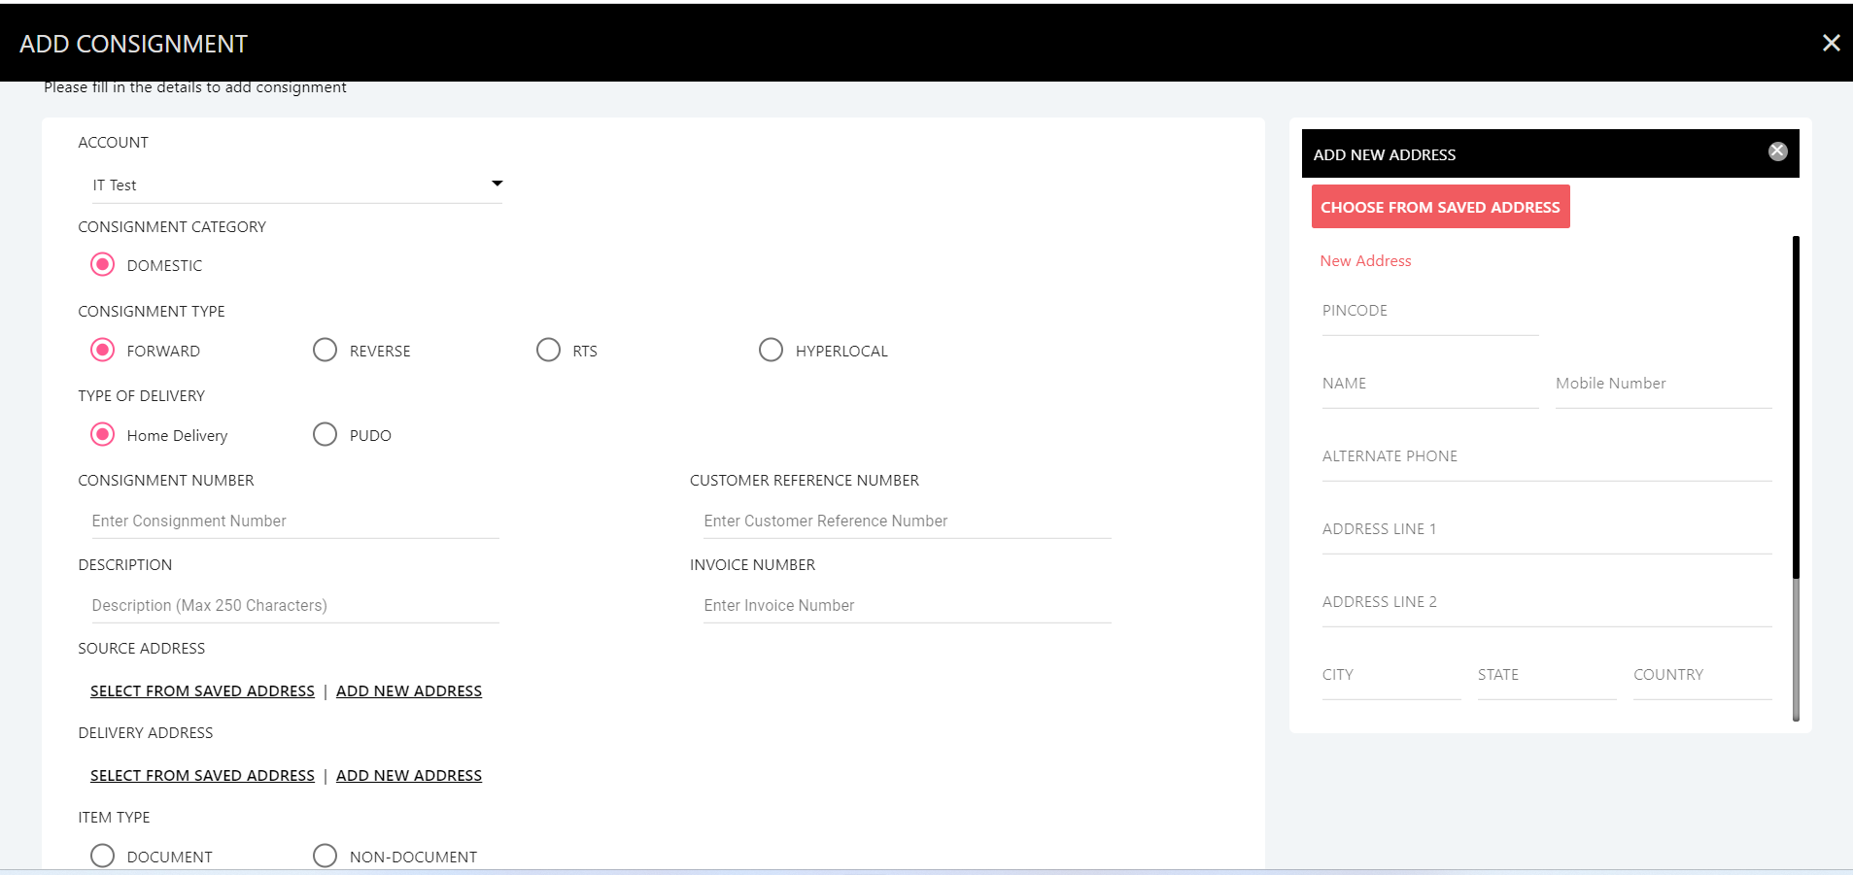
Create Single Shipment - Add Source Address
Enter name sender
Enter phone number
Enter Address
Enter Address
Enter City
Enter district
Enter Country

Slide 24
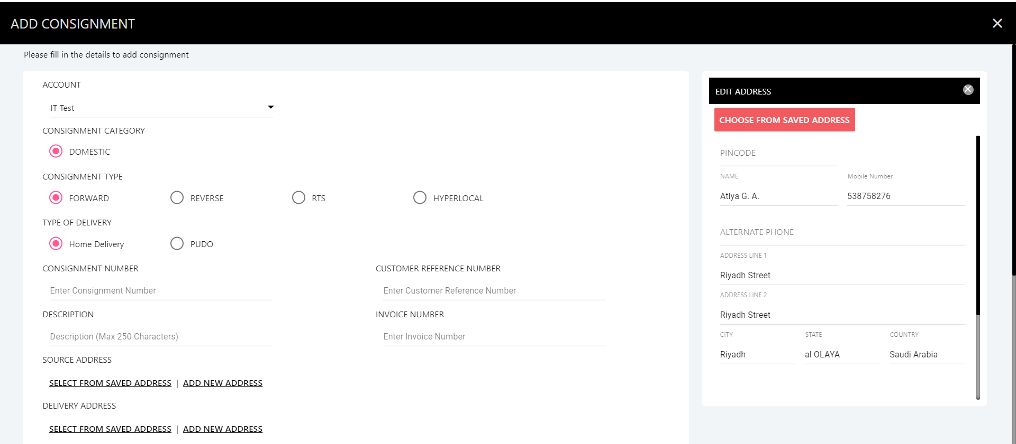
Create Single Shipment - Add Source Address
Click here

Slide 25
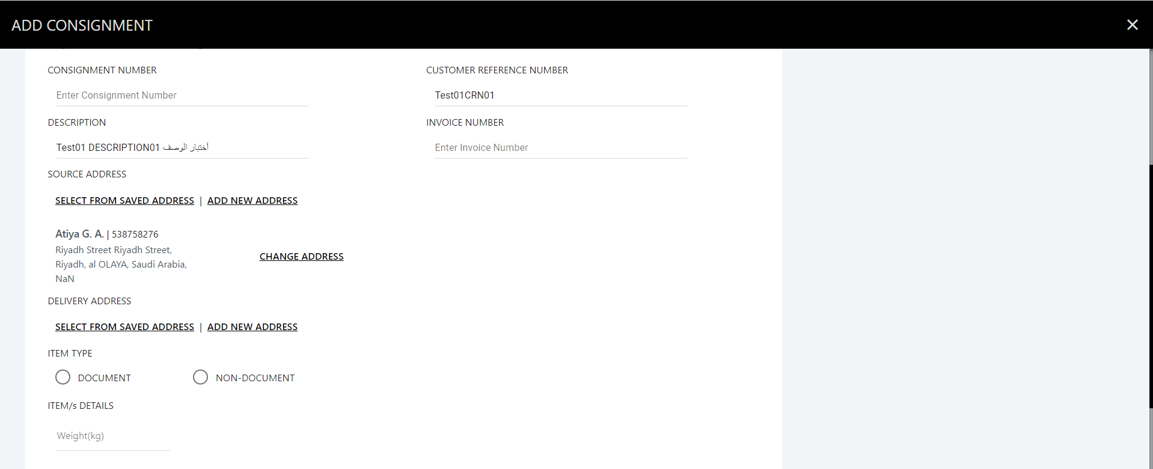
Create Single shipment – Add Delivery Address
Click Here to fill in the delivery address

Slide 26
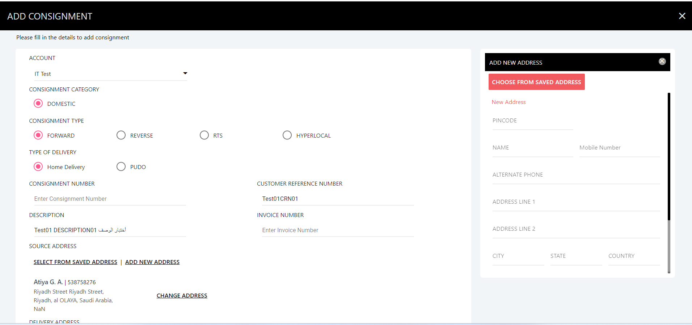
Create Single Shipment - Add Destination Address
Enter name sender
Enter phone number
Enter Address
Enter Address
Enter City
Enter district
Enter Country

Slide 27
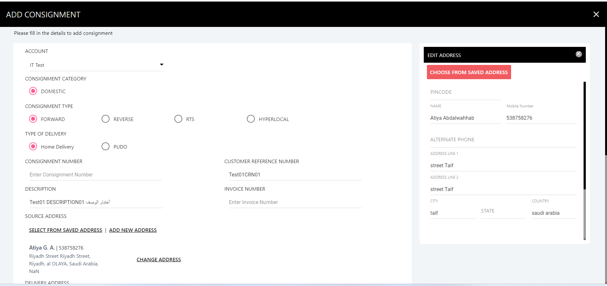
Create Single shipment – Save Delivery Address
Click here

Slide 28
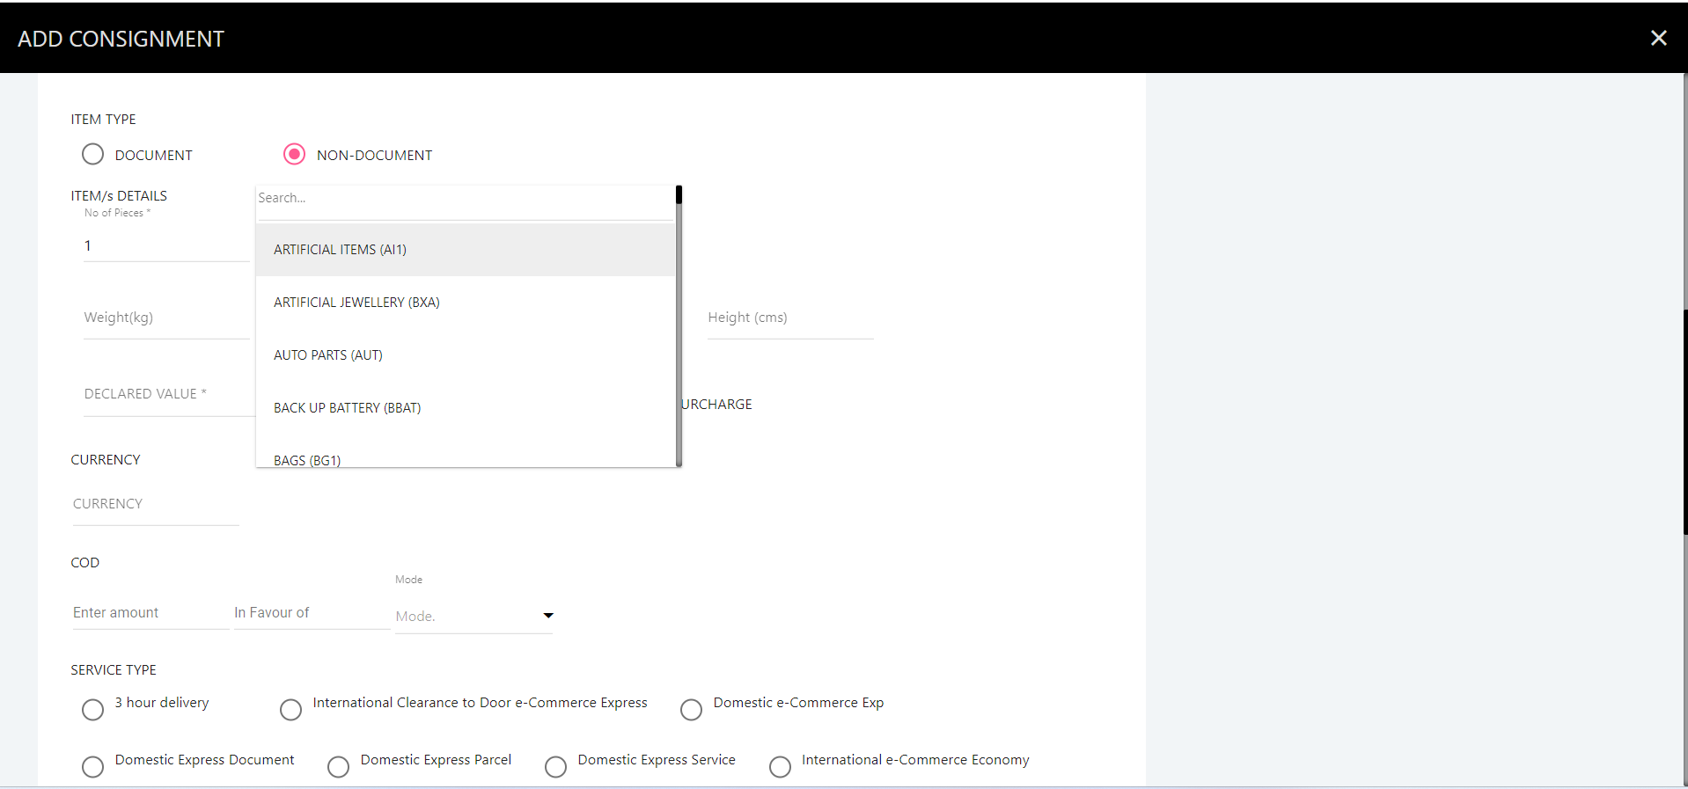
Create Single shipment
Enter the number of pieces
Select Content Type

Slide 29
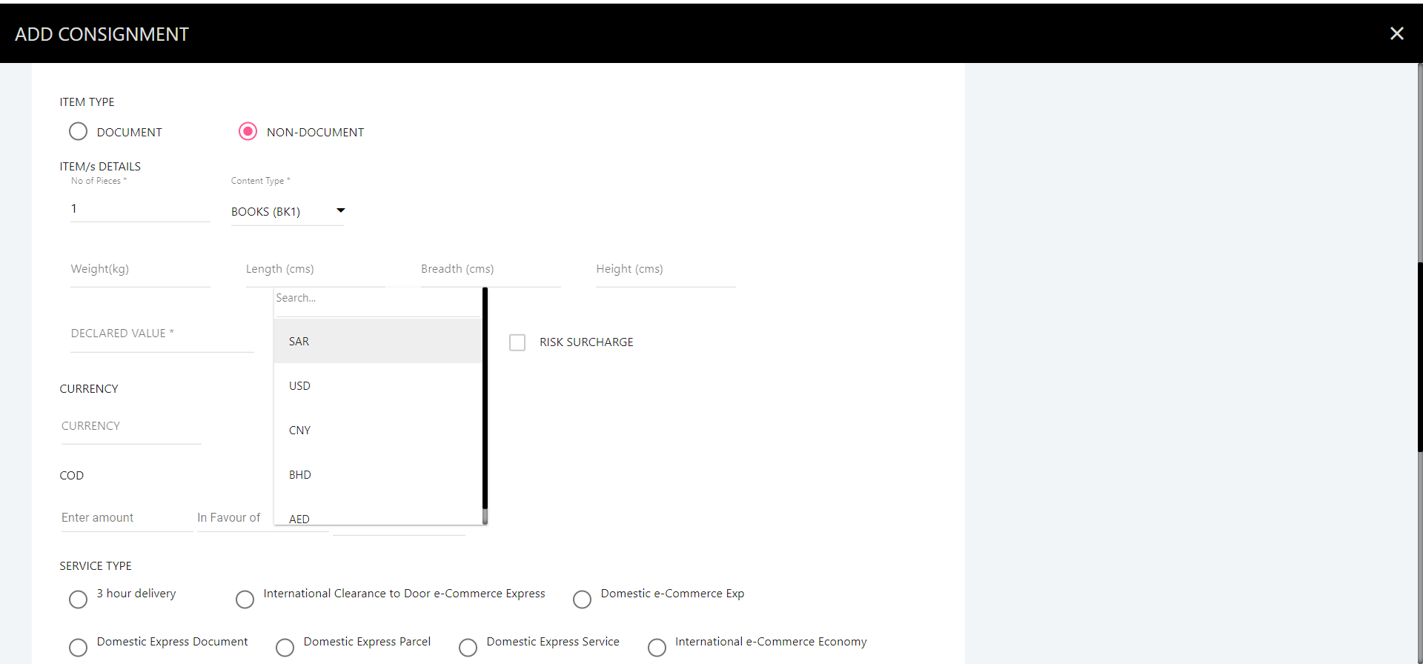
Create Single shipment
Enter weight:
The weight per piece.
Total weight must not exceed max shipment weight as per contract.
Enter weight
Select Currency
Enter Declared value

Slide 30
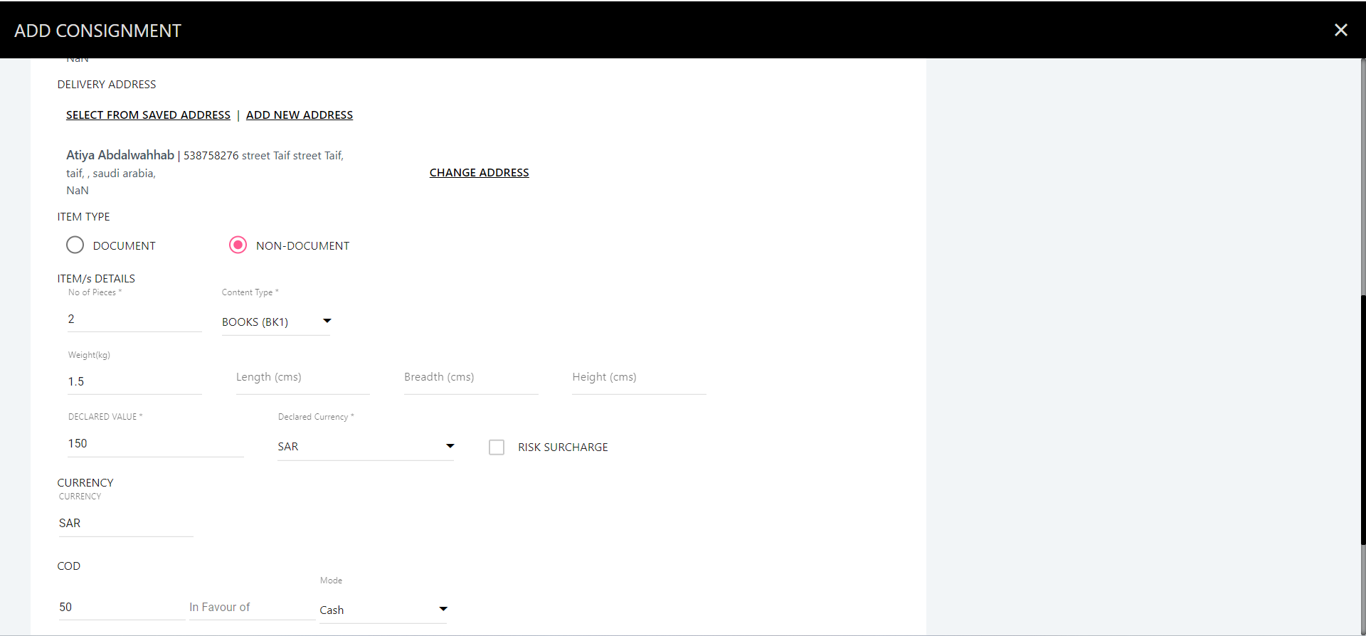
Create Single shipment
Enter Currency for COD
Enter Amount COD
Select Cash

Slide 31
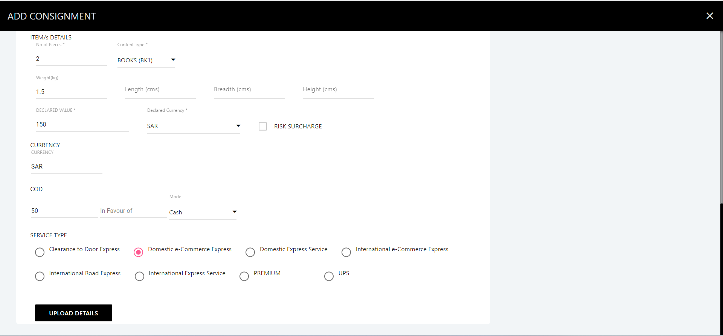
Create Single shipment
Select your services type.
Click Here

Slide 32
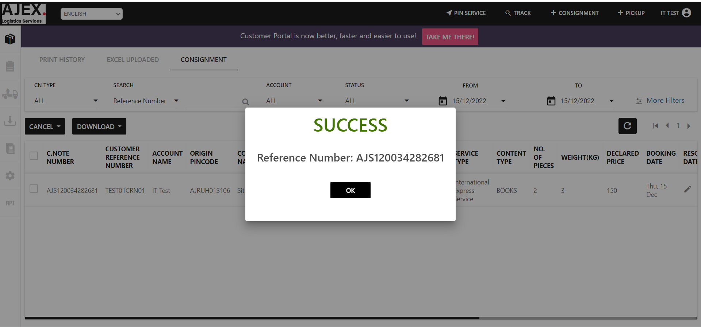
Success Create a Single shipment

Slide 33
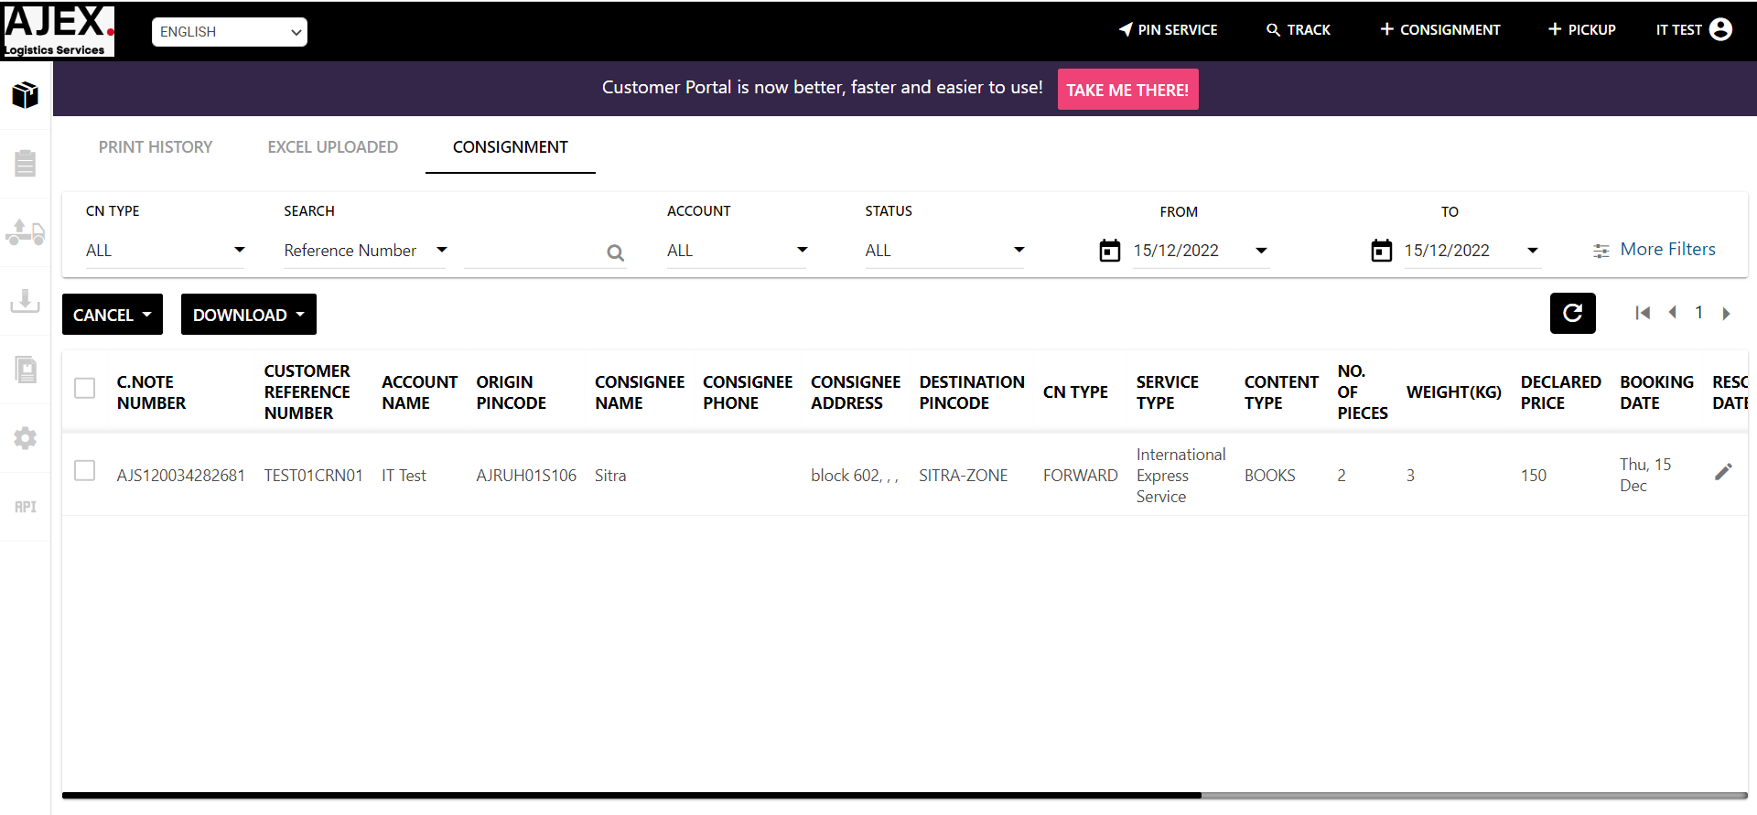
Display your orders as shown in the table

Slide 34
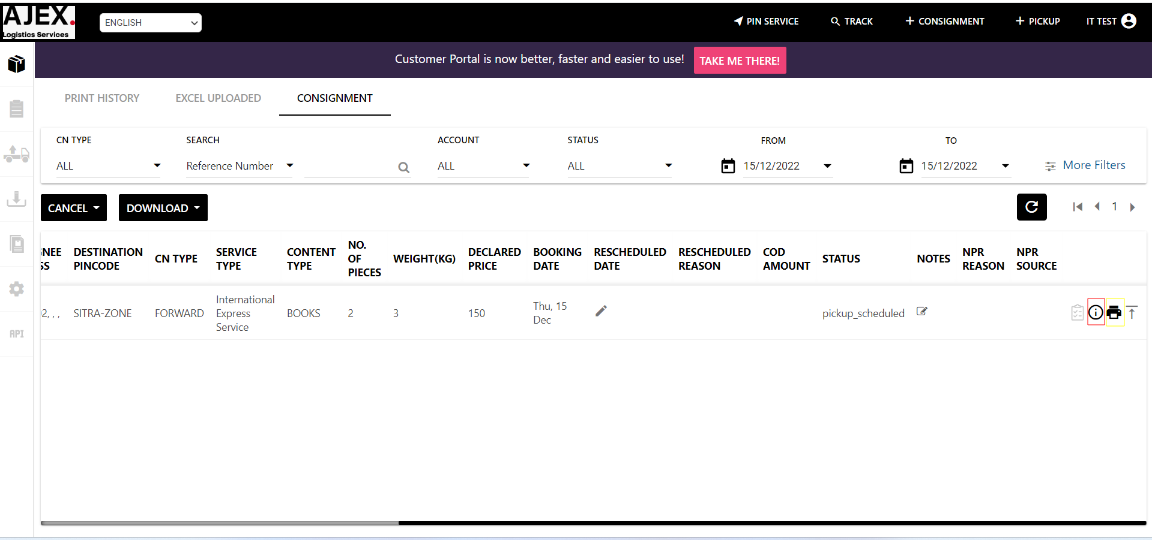
Customer can display details; print od order or waybill
Click here to display details
Click here to print the waybill

Slide 35
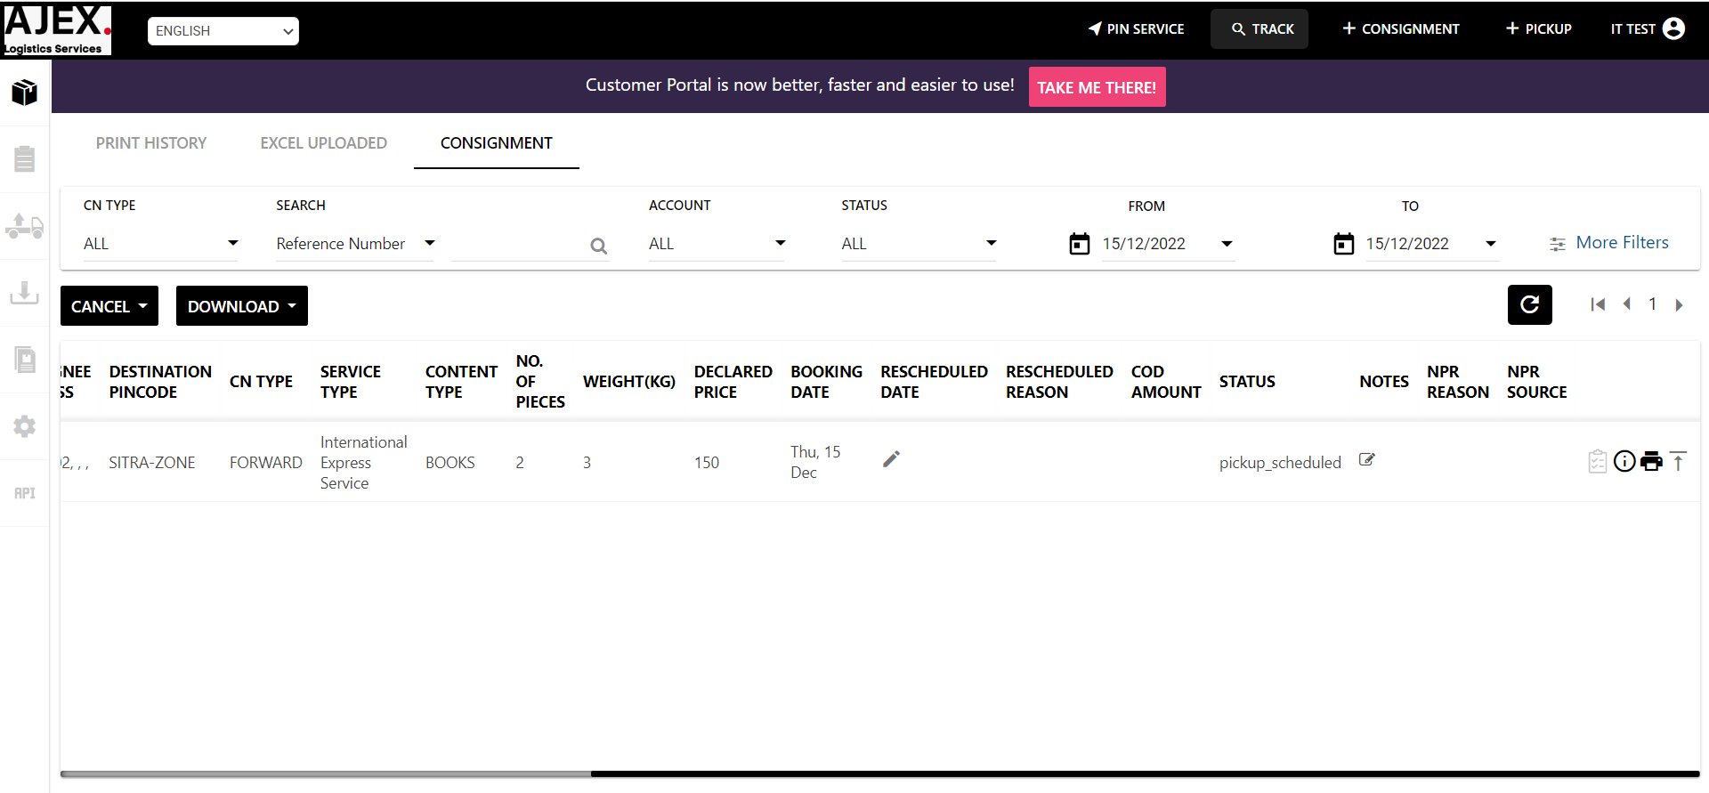
Customer can track his/her orders
Click here

Slide 36
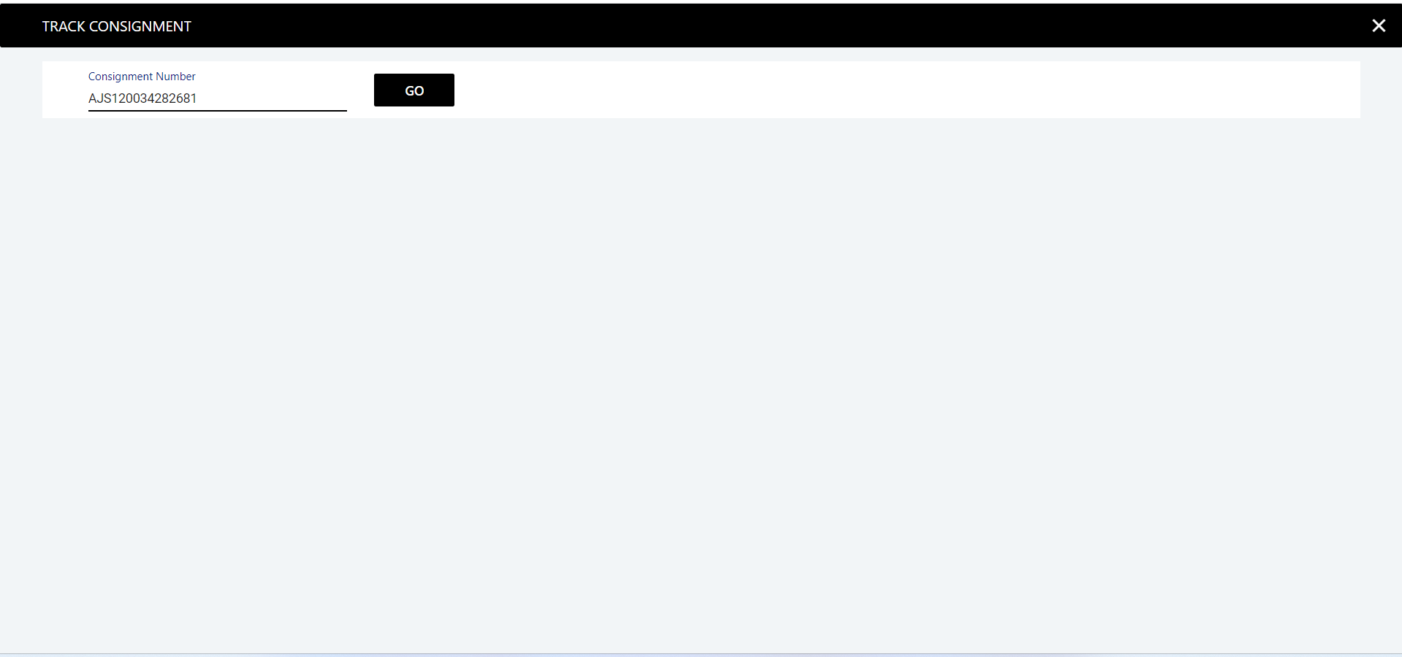
Customer can track his/her orders
Put waybill number here
Click here

Slide 37
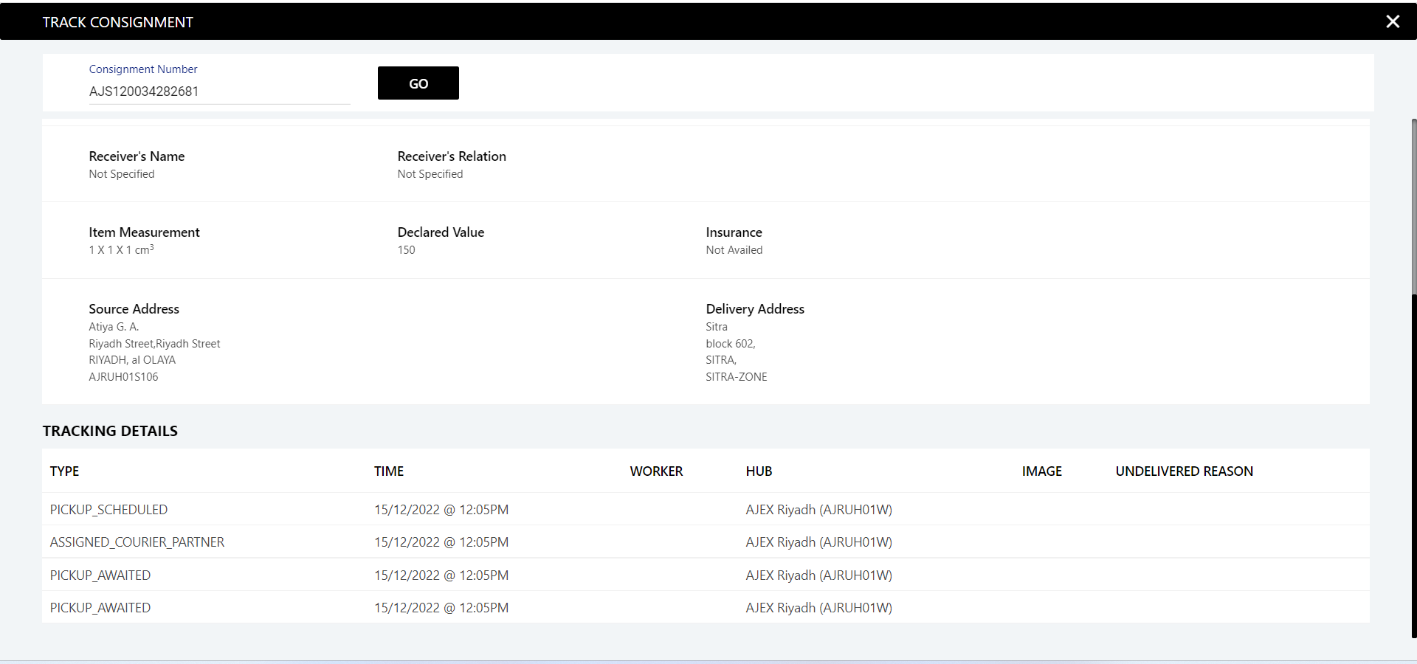
Customer can track his/her orders
Displaying Tracking

